Slide 1
EnviroScan: AI-Powered Pollution Source Identifier
Mahek Rana
Infosys Springboard Internship Program
BE in Computer Science & Technology (CST)
LJ Institute of Engineering and Technology
Mentor: Rahul Sir

Slide 2
Problem Statement: Traditional pollution monitoring systems measure pollutant levels but do not identify their sources, limiting targeted action. This project uses machine learning, weather data, and geospatial analytics to predict pollution sources such as industrial activity, traffic, agricultural burning, or natural causes. By analyzing real-time sensor data, weather conditions, and location features, the system classifies pollution sources, generates geospatial heatmaps, and issues alerts for high-risk areas, enabling data-driven environmental decision-making.
Current Limitations
Existing systems measure pollution levels but fail to identify specific sources, hindering effective intervention.
Our Solution
EnviroScan uses ML, weather data, and geospatial analytics to predict pollution sources like industrial, vehicular, or agricultural.

Slide 3
APPROACH & TECHNOLOGY
Data Sources:
• Air Quality Dataset 2021-2023 (1000+ samples from CPCB)
• OpenWeather API (real-time air quality & weather)
• OSMnx (OpenStreetMap geospatial data)
Machine Learning Model: XGBoost Classifier
Features Used: 12 features total:
4 Pollutants (PM2.5, PM10, NO2, SO2)
3 Weather (Temperature, Humidity, Pressure)
5 Geospatial (Distances to roads, industries, farms, dumps, agricultural)
Tech Stack: Python, Streamlit, Plotly, FPDF2, Kaleido

Slide 4
Milestone 1: Data Foundation (Weeks 1-2)
Module 1: Data Collection
Module 2: Data Cleaning & Feature Engineering
Gather air quality (OpenAQ and CPCB) and weather data (OpenWeatherMap).
Remove duplicates, handle missing values, standardize data.
Extract physical features (roads, industrial zones) via OpenStreetMap.
Calculate spatial proximity and temporal features.
Combine datasets into a unified, feature-rich DataFrame.
Tag data with location and API metadata.

Slide 5
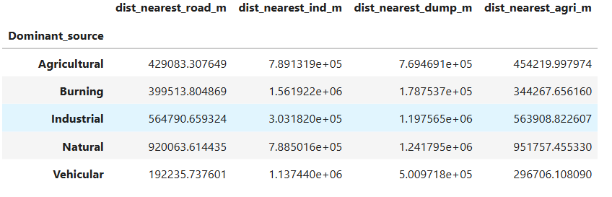
Milestone 2: Intelligence Building (Weeks 3-4)
1
Module 3: Source Labeling & Simulation
Define rules (e.g., road + high NO₂ = Vehicular) to label pollution sources. Simulate data if ground-truth labels are unavailable.
2
Module 4: Model Training & Prediction
Train classification models (Random Forest, XGBoost) on labeled data. Evaluate performance and export the best model.

Slide 6
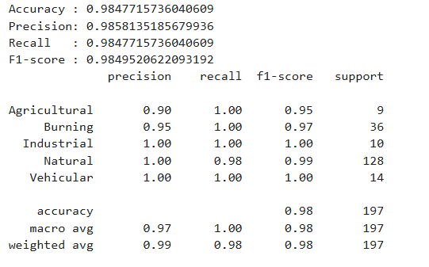
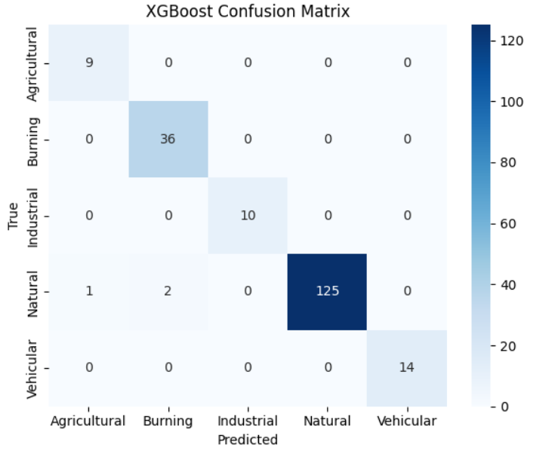
MODEL PERFORMANCE
Models Accuracy:
Decision Tree (~95%)
Random Forest (~97%)
XGBoost (~98%)
Overall Accuracy: 98.48% OF XGBoost
Key Results:
✓ Vehicular: 100% Precision & Recall
✓ Industrial: 100% Precision & Recall
✓ Agricultural: 95% F1-Score
✓ Burning: 97% F1-Score
✓ Natural: 99% F1-Score
Macro Average: 98% Precision, 100% Recall, 98% F1-Score

Slide 7
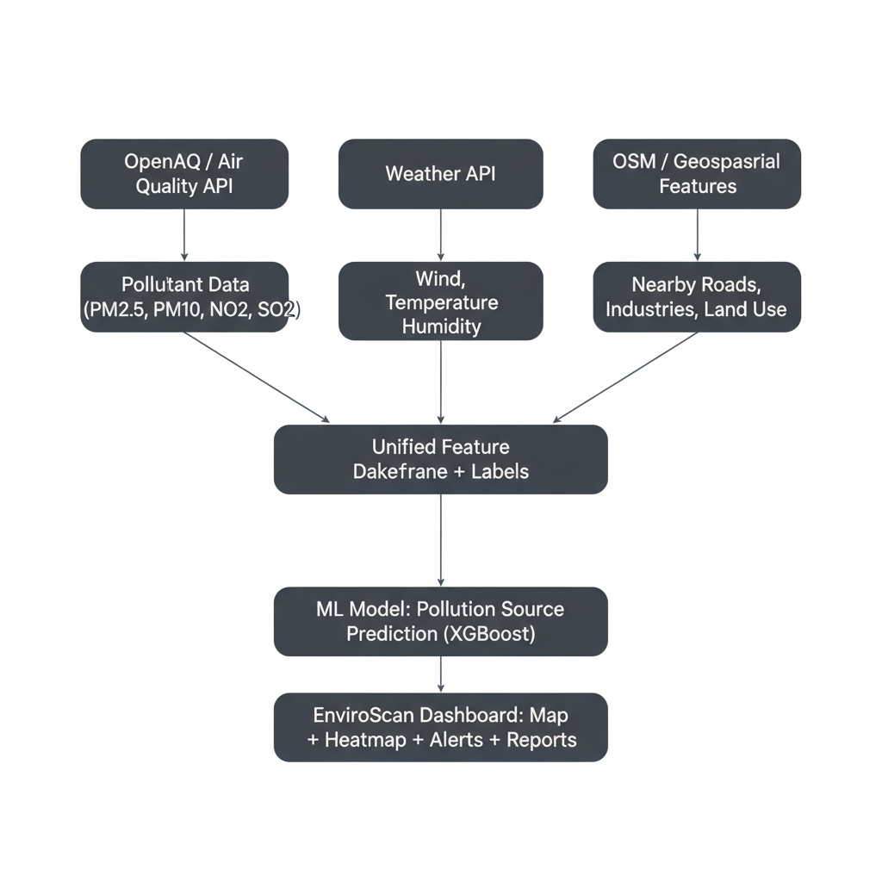
Data Flow and ML Workflow

Slide 8
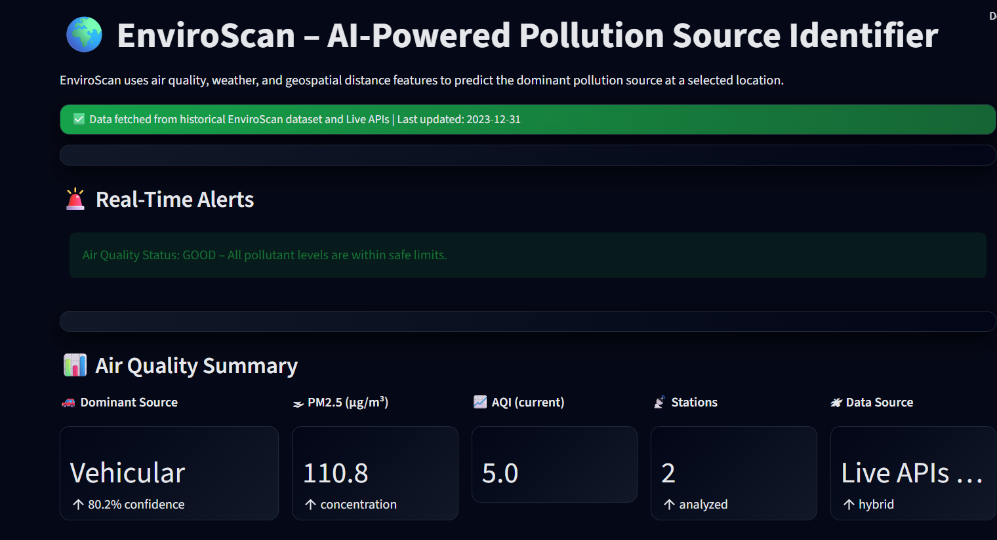
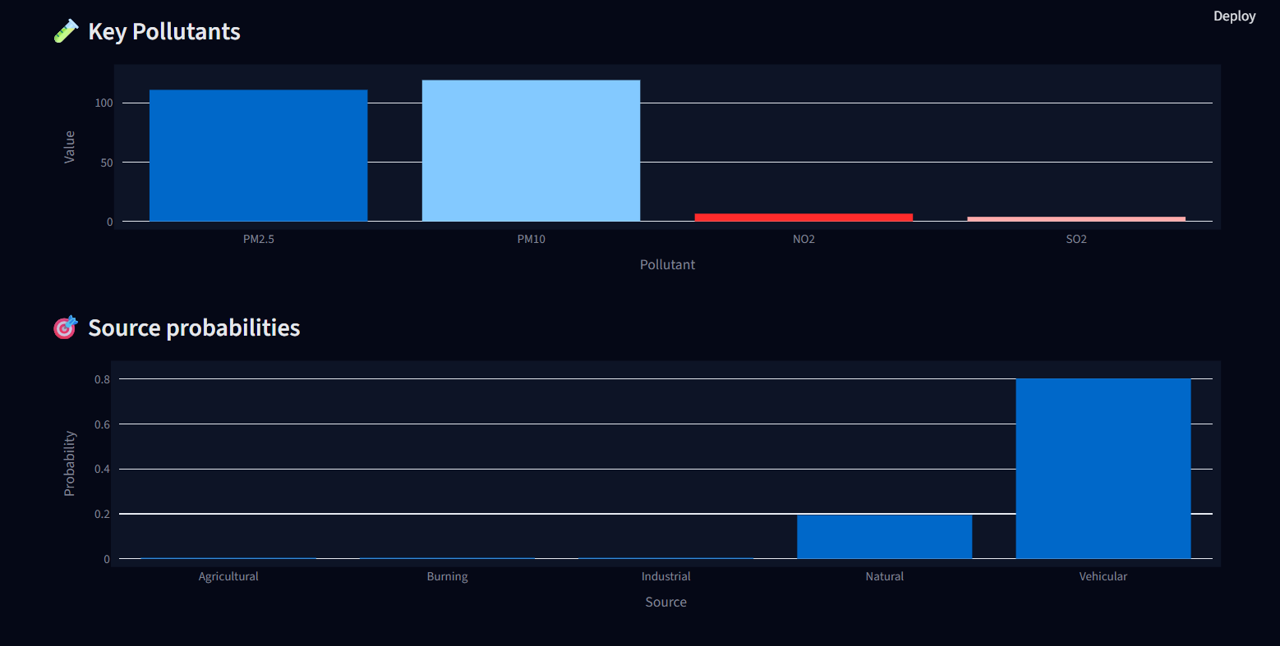
Milestone 3: Visualization & Alerts (Weeks 5-6)
Module 5: Geospatial Mapping
Module 6: Real-Time Dashboard & Alerts
Load predictions onto interactive maps.
Build an interactive dashboard using Streamlit.
Create dynamic heatmaps and source-specific markers.
Display predictions, alerts, trends, and source distribution.
Visualize high-risk zones and allow filtering.
CSV, Excel, PDF reports with embedded charts

Slide 9
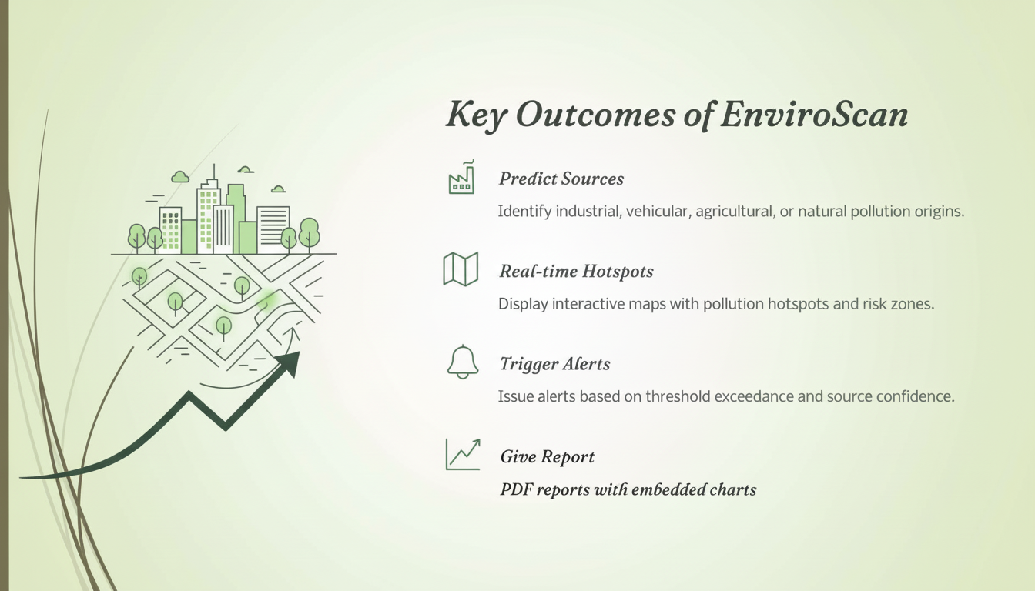

Slide 10
Thank you

